Slide 1
Insertion and Merge Sort
Guangyu Zou
gyzou@dlut.edu.cn
Dalian University of Technology

Slide 2
Review
Data Structures ＋ Algorithms ＝ Programs
Key points
Correctness
Counter-example
Contradiction
Loop Invariant
Mathematical Induction
Efficiency (Complexity)
Space （Data Structure）
Time（Algorithm）

Slide 3
Outline
Problems
Designing solution strategies
Developing algorithms
Writing algorithms that implement the strategies
Understand existing algorithms and modify/reuse
Understanding an algorithm by simulating its operation on an input
Ensuring/proving correctness
Analyzing and comparing performance/efficiency
Theoretically: Using a variety of mathematical tools
Empirically: Code, run and collect performance data
Choosing the best

Slide 4

Bubble Sort

Slide 5
Bubble Sort
void BubbleSort(int a[]) {
for (int i = 0; i < a.length - 1; ++i) {
for (int j = 0; j < a.length-i-1; ++j) {
if (a[j] > a[j+1]) {
int tmp = a[j];
a[j] = a[j+1];
a[j+1] = tmp;
}
}
}
}
Before sorting, the array is
51 16 21 64 69 65 49 78 68 58
After sorting, the array is
16 21 49 51 58 64 65 68 69 78
public static void main(String[] args) {
int[] a = new int[10];
int i = 0;
System.out.println("Before sorting, the array is");
for (i = 0; i < 10; ++i) {
a[i] = (int)(Math.random()*100);
System.out.println(a[i]);
}
BubbleSort(a);
System.out.println("After sorting, the array is");
for (i = 0; i < 10; ++i)
System.out.print(a[i]);
}

Slide 6
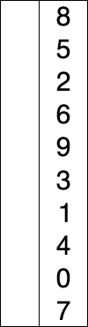
Selection Sort

Slide 7
Selection Sort
void SelectionSort(int[] a) {
for (int i = 0; i < a.length-1; ++i) {
int minIndex = i;
for (int j = i+1; j < a.length; ++j) {
if (a[j] < a[minIndex])
minIndex = j;
}
int tmp = a[i];
a[i] = a[minIndex];
a[minIndex] = tmp;
}
}

Slide 8
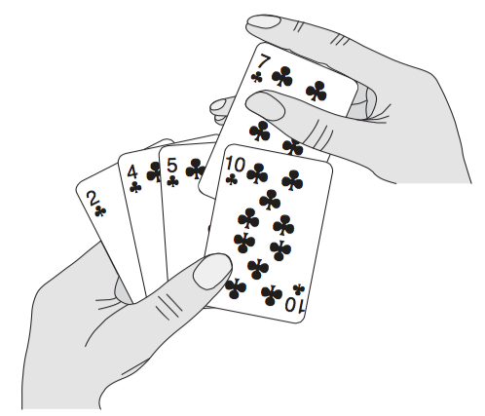
Insertion Sort

Slide 9

Insertion Sort

Slide 10
Insertion sort
Example: Sorting problem
Input: A sequence of n numbers
Output: A permutation of the input sequence such that .
The number that we wish to sort are known as the keys.

Slide 11
Writing Pseudocode
conditional statements: if-then-else
loops: for, while, repeat
assignment
variables
data in arrays
parameter passing: by value for variables; by reference for objects
boolean operations
we will follow the textbook conventions

Slide 12
Pseudocode
Insertion sort
Insertion-sort(A)
1 for j ←2 to length[A]
2 do key←A[j]
3 ∗Insert A[j] into the sorted sequence A[1..j-1]
4 i ← j - 1
5 while i>0 and A[i ]>key
6 do A[i+1] ←A[i ]
7 i ← i - 1
8 A[i +1] ←key

Slide 13
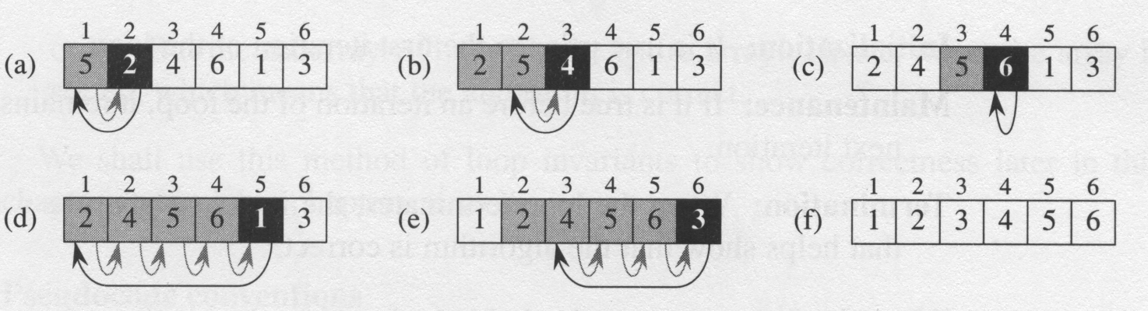
Understanding an Algorithm by Simulating Its Operation on an Input

Slide 14
Interesting Properties of Insertion Sort
Sorted in place :
The numbers are rearranged within the array A, without using an additional data structure (memory).
Loop invariant :
At the start of each iteration of the for loop of line 1-8, the subarray A[1..j-1] consists of the elements originally in A[1..j-1] but in sorted order.

Slide 15
Analyzing algorithms
Assumption: the computer that runs the algorithms is a one processor random access machine (RAM)

Slide 16
Analyzing Algorithms
The time needed by an algorithm to solve a problem depends on the steps of the algorithm that have to be executed (the number of primitive “instructions” or “operations” executed before it halts on a given input and produces an output) and how big the given input is.
We specify this using an expression T(n) where n is the size of the input.
So if we know T(n), we can estimate how much time that computer will take to solve that problem (see example on page 11). Alternately, if we know how much time we have, we can decide the largest size of a problem that can be solved (see problem 1-1 in Chapter 1).

Slide 17
Insertion-sort(A) cost times
1 for j ←2 to length[A]
2 do key←A[j]
3 ⊳Insert A[j] into the
sorted sequence A[1..j -1]
4 i ←j -1
5 while i>0 and A[i ]>key
6 do A[i +1] ←A[i ]
7 i ←i -1
8 A[i +1] ←key
: the number of times the while loop test in line 5 is executed for the value of j.

Slide 18
the running time
for j = 2,3,…,n; what is the best case?

Slide 19
the running time
for j = 2,3,…,n; what is the worst case?
quadratic function on n -> n²;

Slide 20
Best-case, worst-case and average-case analysis
Usually, we calculate only the worst-case running time
Reason:
It is an upper bound on the running time
The worst case occurs fairly often
The average case is often as bad as the worst case. The best case is usually one particular input amongst the large number of possible inputs.

Slide 21
Merge Sort
The divide-and-conquer approach
Divide the problem into a number of subproblems that are smaller instances of the same problem.
Conquer the subproblems by solving them recursively. If the subproblem sizes are small enough, however, just solve the subproblems in a straightforward manner.
Combine the solutions to the subproblems into the solution for the original problem.
Cloud Computing
MapReduce -- Mapper and Reducer

Slide 22
Merge Sort
Divide: Divide the n-element sequence to be sorted into two subsequences of n/2 elements each.
Conquer: Sort the two subsequences recursively using merge sort.
Combine: Merge the two sorted subsequences to produce the sorted answer.
The recursion “bottoms out” when the sequence to be sorted has length 1, in which case there is no work to be done, since every sequence of length 1 is already in sorted order.

Slide 23
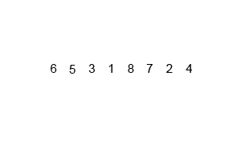
Merge Sort

Slide 24
MERGE-SORT(A,p,r)
1 if p < r
2 then q←⎣(p+r)/2⎦
3 MERGE-SORT(A,p,q)
4 MERGE-SORT(A,q+1,r)
5 MERGE(A,p,q,r)

Slide 25
Merge(A,p,q,r)
1 n₁ ← q – p + 1
2 n₂ ← r – q
3 create array L[ 1 .. n₁ + 1 ] and R[ 1 ..n₂ + 1 ]
4 for i ← 1 to n₁
5 do L[ i ] ←A[ p + i – 1 ]
6 for j ← 1 to n₂
7 do R[ i ] ←A[ q + j ]
8 L[n₁ + 1] ← ∞
9 R[n₂ + 1] ← ∞

Slide 26
Merge(A,p,q,r)
10 i ←1
11 j ←1
12 for k ← p to r
13 do if L[ i ] ≤ R[ j ]
14 then A[ k ] ← L[ i ]
15 i ← i + 1
16 else A[ k ] ← R[ j ]
17 j ← j + 1

Slide 27
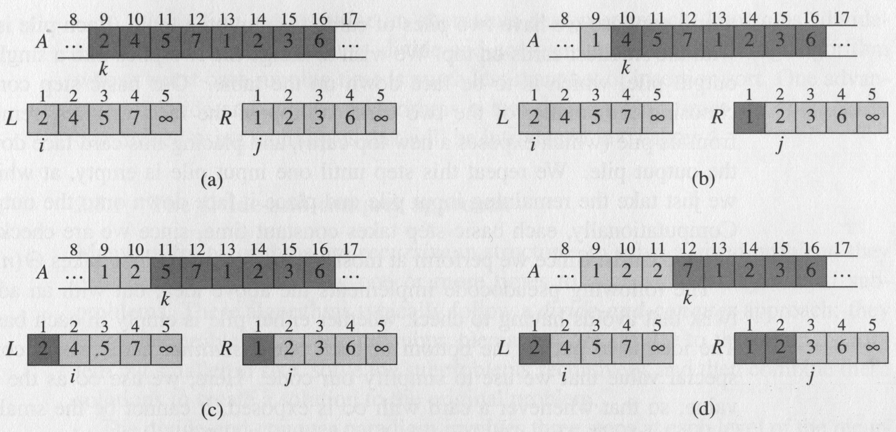
Operation of Merge

Slide 28
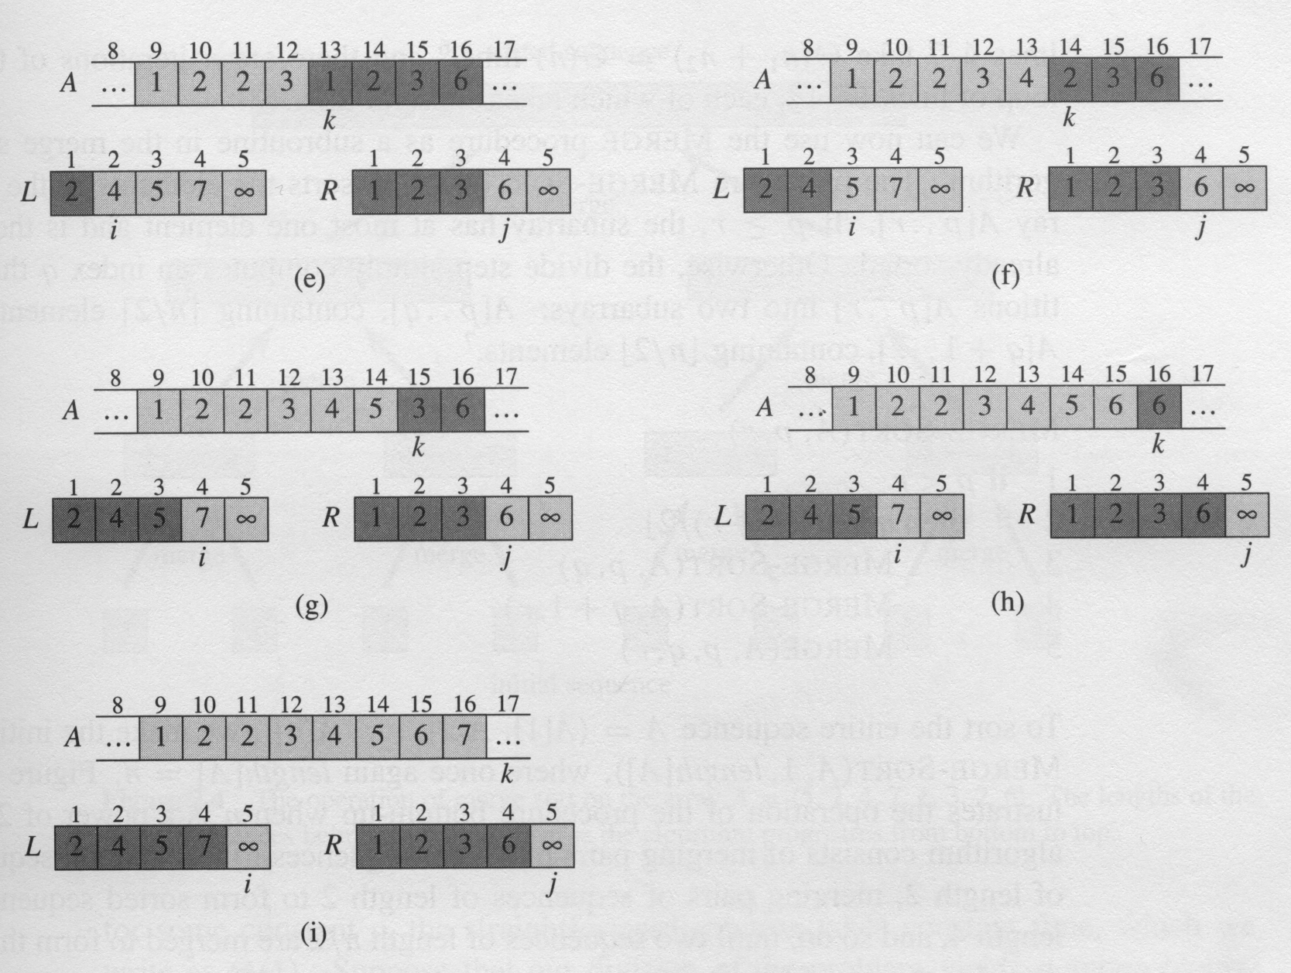

Slide 29
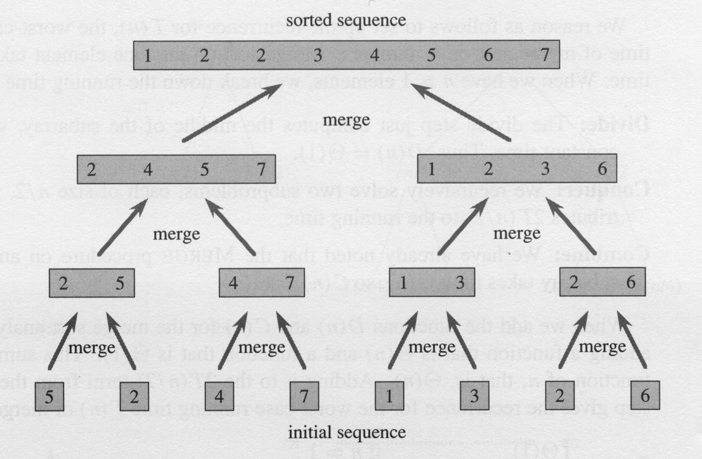
Operation of Merge Sort

Slide 30
How complex is Merge Sort?
Let us try the step-by-step approach we’ve used for analyzing algorithms.
Step# # of times Cost
1 if p < r
2 then q←⎣(p+r)/2⎦
3 MERGE-SORT(A,p,q)
4 MERGE-SORT(A,q+1,r)
5 MERGE(A,p,q,r)
1
c₁
1
c₂
1
???
1
???
1
cn

Slide 31
Analysis of merge sort
where the constant c represents the time require to solve problems of size 1 as well as the time per array element of the divide and combine steps.

Slide 32
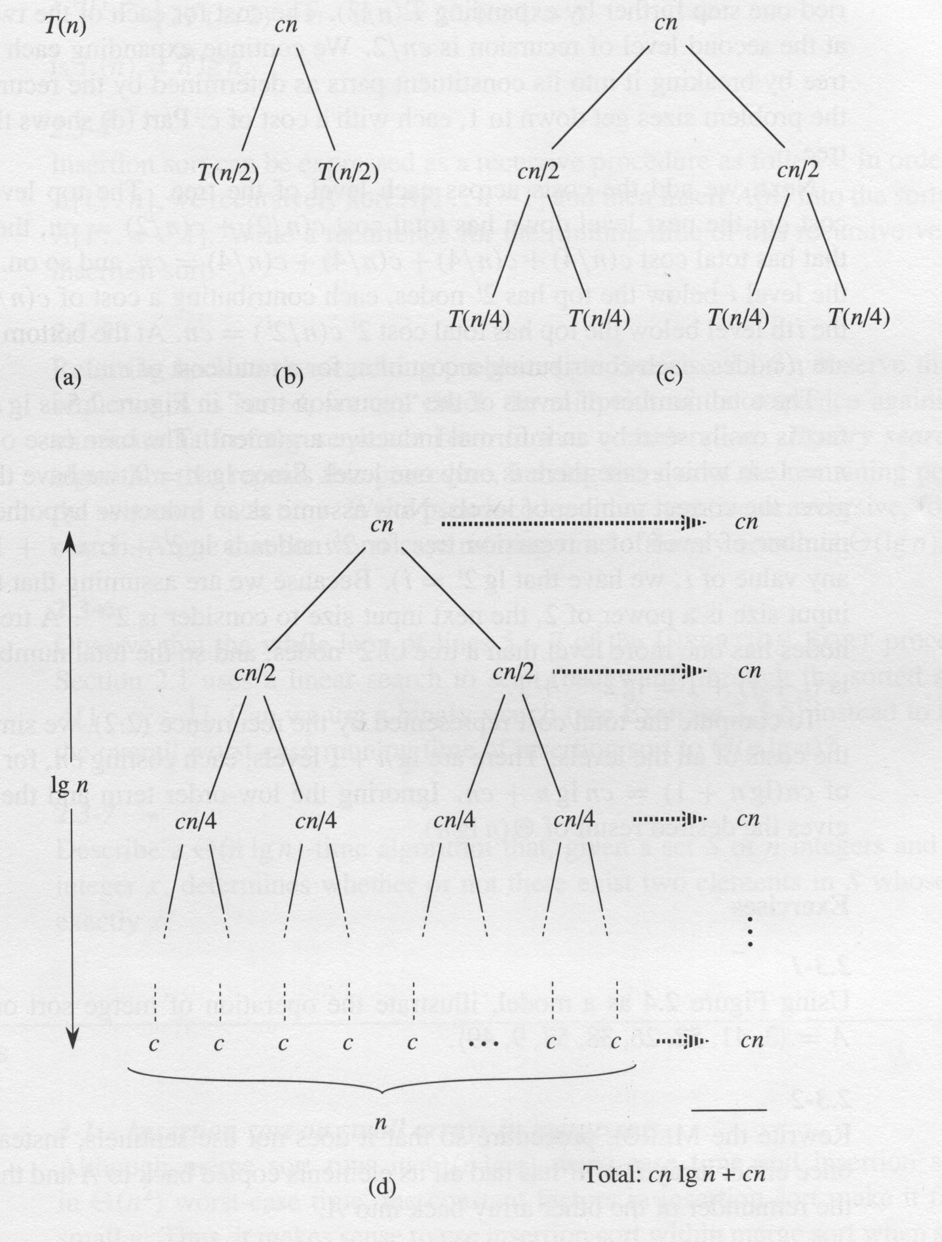
Recursion Tree
O(nlgn)

Slide 33
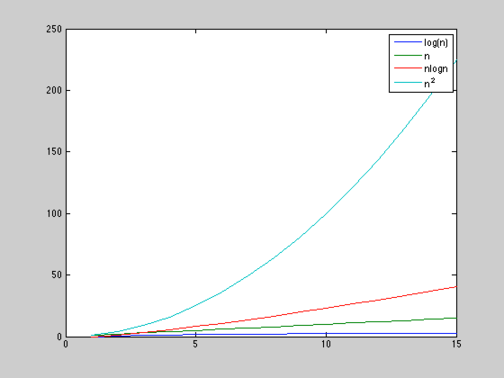
Which is faster? Insertion or Merge?

Slide 34
Designing algorithms
There are many ways to design algorithms. We will discuss these at various times throughout the semester. You have already seen two:
Incremental approach: divide the problem into smaller problems (that may overlap) and use iteration (looping) to solve the smaller problems incrementally until the whole problem is solved.
E.g., parse problem, insertion sort
Divide-and-conquer: divide the problem into non-overlapping subproblems, solve the subproblems recursively and then finish up by combining the subproblem solutions into a solution of the overall problem. E.g., merge sort.

Slide 35
At this point you must have read Chapters 1 & 2 from the textbook. I also suggest that you try out some of the end-of-chapter problems.

Slide 36
Sorting algorithms
Bubble, Selection, Insertion:
Non-recursive
In place: only a constant number of additional storage locations (for local variables) are used outside the array.
Merge sort :
Recursive; Not in place.
Heap sort : (Chapter 6)
Non-recursive
In place
Sorts n numbers in place in O(nlgn)

Slide 37
Sorting algorithm
Quick sort : (chapter 7)
Recursive
In place
Worst time complexity O(n²); Average time complexity O(n logn)
Fastest general purpose sorting algorithm
Linear sorting algorithms : (chapter 8)
Counting sort
Radix sort
Bucket Sort

Slide 38
Review
function find-max(A:array [i...j] of integer)
k: integer
1 if i=j then return A[i]
else
2 k← find-max(A:array [i+1...j])
3 if k>A[i] then return k else return A[i]

Slide 39
Recursive call
[3,1,2,5,4]
max(3, [1,2,5,4])
max(1, [2,5,4])
max(2, [5,4])
max(5, [4])
[4]
5
5
5
5
4
push
pop

Slide 40
Proving Correctness of Recursive Algorithms
To prove that find-max correctly finds the max number in an array of n integers:
1. Proving the Base Cases:
If A is an array of length 1, by definition its element is the max.
Statement 1 of the algorithm returns the single element if array size is 1, so the algorithm is correct for the base case input.

Slide 41
Correctness Proof (contd.)
Making the Inductive Hypothesis
Assume the algorithm returns the correct max element for all arrays of size from 1 to k, for some constant k>=1.

Slide 42
Correctness Proof (contd.)
If k>=1 then k+1>1. So the input array contains more than one element, so j>i, i.e., the condition checking in S#1 will fail, and S#2-S#3 will be executed.
After S#2 is executed, the variable k will contain the max element in the subarray A[i+1…j] of size k (by the Inductive Hypothesis).
S#3 will choose and return the larger of A[i] or k.
I.e., the algorithm will return the larger of the first element of the array and the max element in the rest of the array when the input is of size k+1.

Slide 43
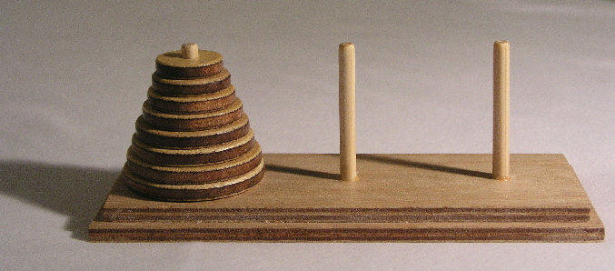

Hanoi Tower
Only one disk can be moved at a time.
Each move consists of taking the upper disk from one of the stacks and placing it on top of another stack i.e. a disk can only be moved if it is the uppermost disk on a stack.
No disk may be placed on top of a smaller disk.

Slide 44
Hanoi Tower
If n = 1
Move disc 1 from origin to destination.
If n > 1
Move the top n-1 disc from origin to the auxiliary pole through destination.
Move the disc n from origin to destination.
Move the n-1 disc from the auxiliary pole to destination through the origin.

Slide 45
A
B
C
1
2
3
A
B
C
1
2
A
B
C
1

